Slide 1


Tabu Search
Manuel Laguna
Notes:
This is Cover page comp one

Slide 2
Outline
Background
Short Term Memory
Long Term Memory
Related Tabu Search Methods

Slide 3
Background
Tabu search is a metaheuristic that guides a local search procedure to explore the solution space beyond local optimality
Memory-based strategies are the hallmark of tabu search approaches

Slide 4
Basic Concepts
Solution
  Initial
  Current
  Best
Move
  Attributes
  Value
Neighborhood
  Original
  Modified (Reduced or Expanded)
Tabu
  Status
  Activation rules

Slide 5
History
A very simple memory mechanism is described in Glover (1977) to implement the oscillating assignment heuristic
Glover, F. (1977) “Heuristics for Integer Programming Using Surrogate Constraints,”
Decision Sciences, vol. 8, no. 1, pp. 156-166.

Slide 6
History
Glover (1986) introduces tabu search as a “meta-heuristic” superimposed on another heuristic
Glover, F. (1986) “Future Paths for Integer Programming and Links to Artificial Intelligence,”
Computer and Operations Research, vol. 13, no. 5, pp. 533-549.

Slide 7
History
Glover (1989a) and (1989b) provide a full description of the method
Glover, F. (1989a) “Tabu Search – Part I,” INFORMS Journal on Computing, vol. 1, no. 3, pp. 190-206.
Glover, F. (1989b) “Tabu Search – Part II,” INFORMS Journal on Computing, vol. 2, no. 1, pp. 4-32.

Slide 8
Tabu Search Framework
Heuristic
procedure
Generate initial solution
and initialize memory
structures
Stop
Tabu restrictions
Candidate lists
Aspiration criteria
Elite solutions
No
Construct modified
neighborhood
Yes
More iterations?
Modified choice rules for diversification or intensification
Short and long term memory
Select best
neighbor
Update memory
structures
Restarting
Strategic oscillation
Path relinking
Execute specialized
procedures
Update best solution

Slide 9
Short-Term Memory
The main goal of the STM is to avoid reversal of moves and cycling
The most common implementation of the STM is based on move attributes and the recency of the moves

Slide 10
Example 1
After a move that changes the value of x_{i} from 0 to 1, we would like to prevent x_{i} from taking the value of 0 in the next TabuTenure iterations
  Attribute to record: i
  Tabu activation rule: move (x_{i} ← 0) is tabu if i is tabu-active

Slide 11
Example 2
After a move that exchanges the positions of element i and j in a sequence, we would like to prevent elements i and j from exchanging positions in the next TabuTenure iterations
  Attributes to record: i and j
  Tabu activation rule: move (i ↔ j) is tabu if both i and j are tabu-active

Slide 12
Example 3
After a move that drops element i from and adds element j to the current solution, we would like to prevent element i from being added to the solution in the next TabuAddTenure iterations and prevent element j from being dropped from the solution in the next TabuDropTenure iterations
  Attributes to record: i and j
  Tabu activation rules:
    move (Add i) is tabu if i is tabu-active
    move (Drop j) is tabu if j is tabu-active

Slide 13
Tabu or not Tabu
Only moves can be tabu. Attributes are never tabu, they can only be tabu-active
A move may be tabu if it contains one or more tabu-active attributes
The classification of a move (as tabu or not tabu) is determined by the tabu-activation rules

Slide 14
TabuEnd Memory Structure
This memory structure records the time (iteration number) when the tabu-active status of an attribute ends
Update after a move
  TabuEnd(Attribute) = Iter + TabuTenure
Attribute is active if
  Iter ≤ TabuEnd(Attribute)

Slide 15
Tabu Decision Tree
Move
Does the move contain
tabu-active attributes?
Yes
Is the move tabu?
No
Yes
No
Does the move satisfy
the aspiration criteria?
Yes
No
Move is admissible
Move is not admissible

Slide 16
Search Flexibility
The number of admissible moves in the neighborhood of the current solution depends on the …
  Move type
  Tabu activation rules
  Tabu tenure
  Aspiration criteria

Slide 17
Example 4
Elements
A
B
C
D
E
Positions
1
2
2
3
4
5
Tabu activation rule: move (B ↔ *) is tabu
B
C
D
E
A
Tabu move
B
C
D

Slide 18
Example 5
Elements
A
B
C
D
E
Positions
1
2
3
4
5
Tabu activation rule: move (B ↔ *) is tabu if B moves to 2 or earlier
B
C
D
E
A
Tabu move
B
C
D

Slide 19
Example 6
Elements
A
B
C
D
E
Positions
1
2
3
4
5
Tabu activation rule: move (B ↔ D) is tabu
B
C
D
E
A
Tabu move
B
C
D

Slide 20
Tabu Tenure Management
Static Memory
  The value of TabuTenure is fixed and remains fixed during the entire search
  All attributes remain tabu-active for the same number of iterations
Dynamic Memory
  The value of TabuTenure is not constant during the search
  The length of the tabu-active status of attributes varies during the search

Slide 21
Simple Dynamic Tabu Tenure
Update after a move
  TabuEnd(Attribute) = Iter + U(MinTenure, MaxTenure)
The values of MinTenure and MaxTenure are search parameters

Slide 22
Aspiration Criteria
By Objective
  A tabu move becomes admissible if it yields a solution that is better than an aspiration value
By Search Direction
  A tabu move becomes admissible if the direction of the search (improving or non-improving) does not change

Slide 23
Candidate List Strategies
Candidate lists are used to reduce the number of solutions examined on a given iterations
They isolate regions of the neighborhood containing moves with desirable features

Slide 24
First Improving
Choose the first improving move during the exploration of the current neighborhood
This is a special case of the Aspiration Plus Candidate List Strategy
  Threshold = Current Solution Value
  Plus = 0
  Min = 0
  Max = Size of the neighborhood

Slide 25
Example 7
Move
Iteration 1
Iteration 2
Iteration 3
Iteration 4
1
NI(1)
NI(2)
NI(5)
2
NI(2)
NI(3)
NI(6)
3
NI(3)
NI(4)
NI(7)
4
I
NI(5)
NI(8)
5
NI(1)
NI(6)
NI(9)
6
NI(2)
I
NI(10)
7
NI(3)
NI(1)
8
NI(4)
NI(2)
9
I
NI(3)
10
NI(1)
NI(4)
Chosen move

Slide 26
Long Term Memory
Frequency-based memory
Strategic oscillation
Path relinking

Slide 27
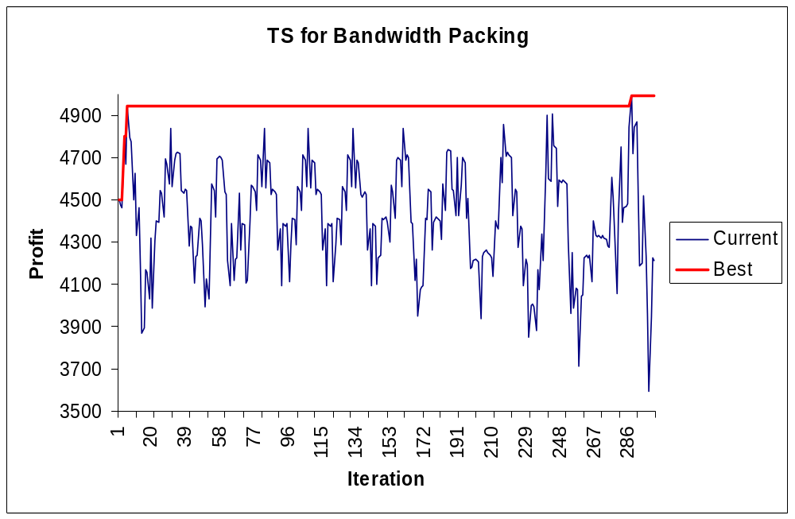
Effect of Long Term Memory

Slide 28
Frequency-based Memory
Transition Measure
  Number of iterations where an attribute has been changed (e.g., added or deleted from a solution)
Residence Measure
  Number of iterations where an attribute has stayed in a particular position (e.g., belonging to the current solution)

Slide 29
Example 8
Transition Measure
  Number of times that element i has been moved to an earlier position in the sequence sequence
Residence Measure
  Number of times that element i has occupied position k

Slide 30
Modifying Choice Rules
Frequency-based memory is typically used to modify rules for …
  choosing the best move to make on a given iteration
  choosing the next element to add to a restarting solution
The modification is based on penalty functions

Slide 31
Modifying Move Values for Diversification
Modified move value = Move value – Diversification parameter * F(frequency measure)
Rule
  Choose the move with the best move value if at least one admissible improving move exists
  Otherwise, choose the admissible move with the best modified move value

Slide 32
Example 9
The frequency of elements occupying certain positions can be used to bias a construction procedure and generate new restarting points
For instance, due dates can be modified with frequency information (of jobs finishing on time) before reapplying the EDD rule

Slide 33
Strategic Oscillation
Strategic oscillation operates by orienting moves in relation to a boundary
Such an oscillation boundary often represents a point where the method would normally stop or turn around

Slide 34
Example 10
In the knapsack problem, a TS may be designed to allow variables to be set to 1 even after reaching the feasibility boundary
After a selected number of steps, the direction is reversed by choosing moves that change variables from 1 to 0

Slide 35
Example 11
In the Min k-Tree problem, edges can be added beyond the critical level defined by k
Then a rule is applied to delete edges
Different rules would be typically used to add and delete edges

Slide 36
Path Relinking
This approach generates new solutions by exploring trajectories that connect elite solutions
The exploration starts from an initiating solution and generates a path in the neighborhood space that leads to a guiding solution
Choice rules are designed to incorporate attributes contained in the guiding solution

Slide 37
Relinking Solutions
Guiding solution
Initiating solution
Original path
Relinked path

Slide 38
Multiple Guiding Solutions
Guiding solution
Initiating solution
Original path
Relinked path

Slide 39
Linking Solutions
Initiating solution
Guiding solution
Original path
Relinked path

Slide 40
GRASP with Path Relinking
Originally suggested in the context of Graph Drawing by Laguna and Martí (1999)
Extensions and a comprehensive review are due to Resende and Riberio (2003) “GRASP with Path Relinking: Recent Advances and Applications” http://www.research.att.com/~mgcr/doc/sgrasppr.pdf

Slide 41
Relinking Strategies
Periodical relinking ⎯ not systematically applied to all solutions
Forward relinking ⎯ worst solution is the initiating solution
Backward relinking ⎯ best solution is the initiating solution
Backward and forward relinking ⎯ both directions are explored
Mixed relinking ⎯ relinking starts at both ends
Randomized relinking ⎯ stochastic selection of moves
Truncated relinking ⎯ the guiding solution is not reached

Slide 42
Related TS Methods
Probabilistic Tabu Search
Tabu Thresholding
Reactive Tabu Search

Slide 43
Probabilistic Tabu Search
Create move evaluations that include reference to tabu strategies, using penalties or inducements to modify a standard choice rule
Map these evaluations to positive weights to obtain probabilities
Chose the next move according to the probability values

Slide 44
Simple Tabu Thresholding
Improving Phase
  Construct S*, the set of improving moves in the current neighborhood
  If S* is empty, execute the Mixed Phase. Otherwise select the probabilistic best move in S*
Mixed Phase
  Select a value for the TabuTiming parameter
  Select the probabilistic best move from the current neighborhood (full or reduced)
  Continue for TabuTiming iterations and then return to Improving Phase

Slide 45
Some Tabu Thresholding Related Applications
Bennell J. A. and K.A. Dowsland (1999) “A Tabu Thresholding Implementation for the Irregular Stock Cutting Problem,” International Journal of Production Research, vol. 37, no. 18, pp. 4259-4275
Kelly, J. P., M. Laguna and F. Glover (1994) “A Study of Diversification Strategies for the Quadratic Assignment Problem,” Computers and Operations Research, vol. 21, no. 8, pp. 885-893.
Valls, V., M. A. Perez and M. S. Quintanilla (1996) “Modified Tabu Thresholding Approach for the Generalized Restricted Vertex Coloring Problem,” in Metaheuristics: Theory and Applications, I. H. Osman and J. P. Kelly (eds.), Kluwer Academic Publishers, pp. 537-554
Vigo, D. and V. Maniezzo (1997) “A Genetic/Tabu Thresholding Hybrid Algorithm for the Process Allocation Problem,” Journal of Heuristics, vol. 3, no. 2, pp. 91-110

Slide 46
Reactive Tabu Search
Proposed by Battiti and Tecchiolli (1994)
Based on keeping a record of all the solutions visited during the search
Tabu tenure starts at 1 and is increased when repetitions are encountered and decreased when repetitions disappear
Hashing and binary trees are used to identify repetitions

Slide 47
RTS Mechanisms
Reaction Mechanism (Self-adjusting tabu tenure)
  CycleMax (to trigger increases of the tabu tenure)
  α (to calculate a moving average of the cycle length and control decreases of the tabu tenure)
  Increase (a value greater than 1)
  Decrease (a value less than 1)
Escape Mechanism (Random moves)
  Rep (repetition threshold)
  Chaos (threshold to determine chaotic behavior)

